Slide 1
King County House Pricing
Real Estate Development Recommendations
By:
John Bruemmer
Nazar Mohl
Woojin Jun

Slide 2
Stakeholder And Business Problem
Stakeholder:
A midsized real estate developer in King County
Problem:
Which factors of a home most influence price and by how much

Slide 3
Study Goals
Analyze King County Real Estate and Pricing Data
Advise Real Estate Developer on
Optimal locations to develop
Profitable house configurations

Slide 4
Available Data
King County House Sales dataset
Income and Population for Each Zip Code
Notes:
Unused data columns: `id`, `date`, `sqft_lot`, `floors`, `waterfront`, `view`, `condition`, `grade`, `sqft_above`, `sqft_basement`, `yr_built`, `yr_renovated`, `lat`, `sqft_living15`, `sqft_lot15`

Slide 5
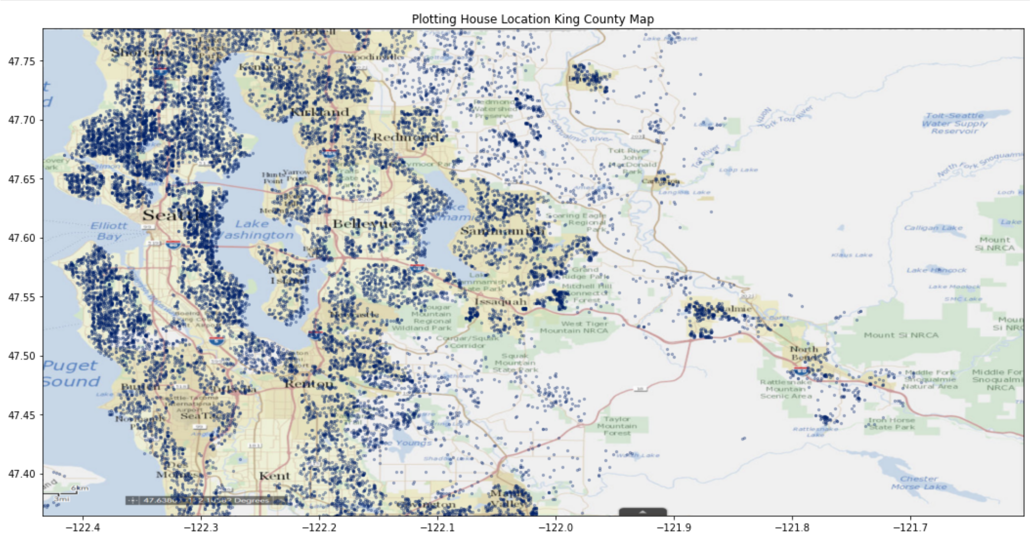
House Locations on King County Map
Notes:
Unused data columns: `id`, `date`, `sqft_lot`, `floors`, `waterfront`, `view`, `condition`, `grade`, `sqft_above`, `sqft_basement`, `yr_built`, `yr_renovated`, `lat`, `sqft_living15`, `sqft_lot15`

Slide 6
Regression Results
Base Model:
R-Squared: .45
Improved Model:
R-Squared - .70

Slide 7
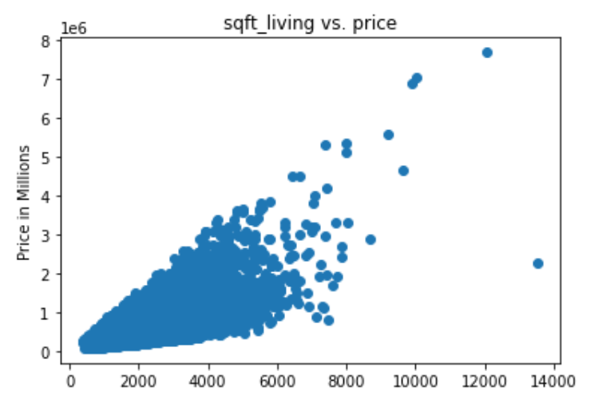
Price vs. Sq Ft Living Space

Slide 8
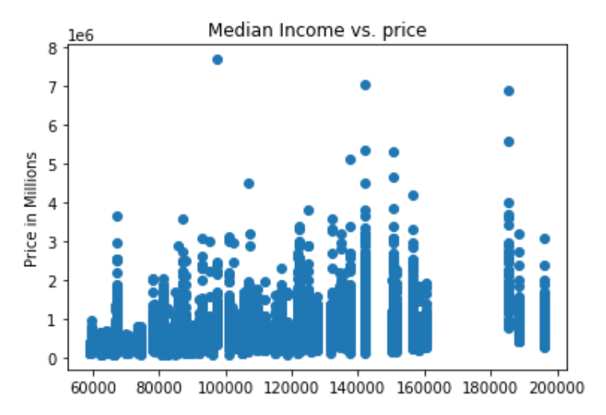
Price vs. Median Income of Zip Code
Using Median income as proxy for location value.
$1 increase in median income = price increase $3.34.

Slide 9
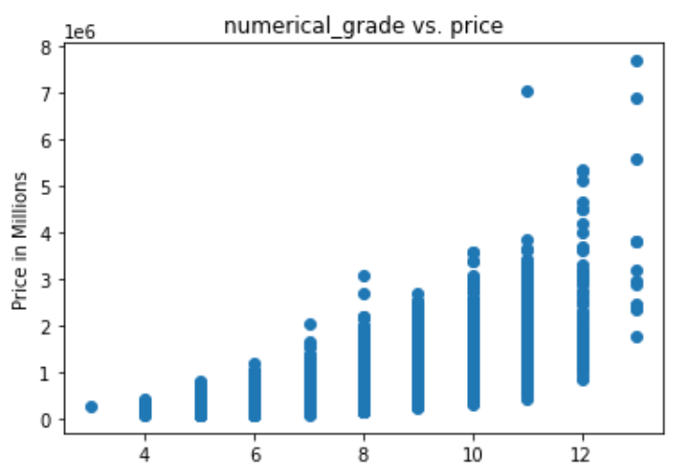
Price vs. Overall Grade of House

Slide 10
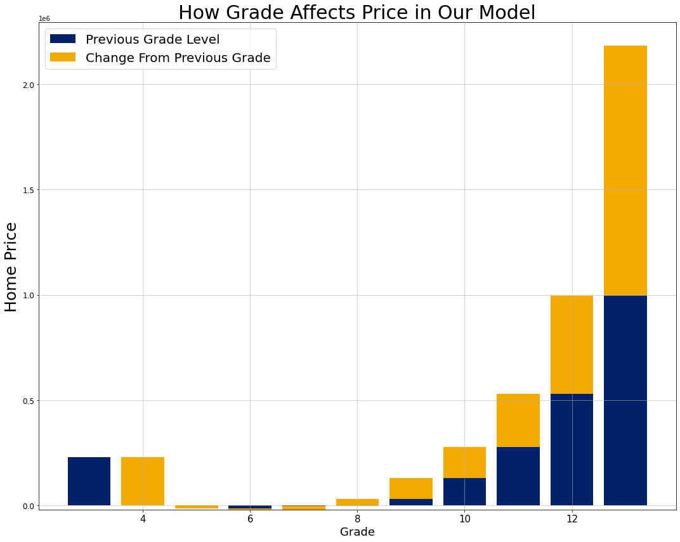
Effect of Grade on House Price
Develop properties with above average or very high overall grade
Increase in price across upper grades is exponential
If increase in costs across grades is linear, then focus on upper grades.

Slide 11
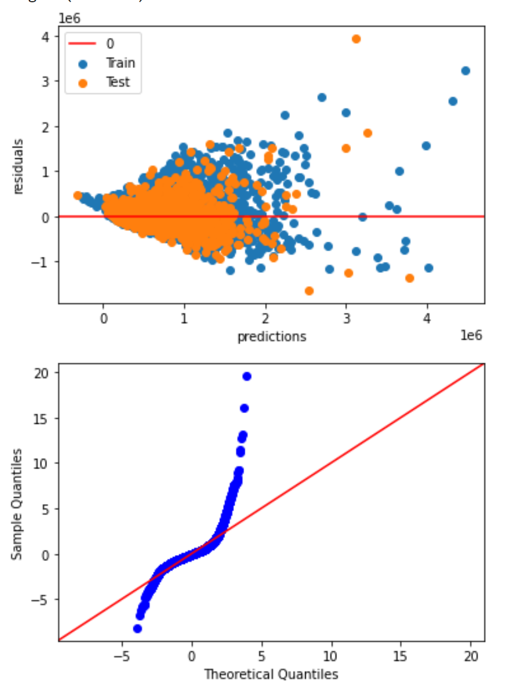
Regression Analysis
Factors:
Location
Neighborhood Median Income
Waterfront
View
House Size
Living Square Feet
House Grade
R-Squared improved by .24
Notes:
Acknowledge the limitations of the model here. Explain in laymen’s terms why the extremes become less reliable. Find where model goes over or under specifically.

Slide 12
Recommendations
Build homes with average or exceptional grades
Use locational data to prioritize underpriced homes in good locations

Slide 13
Next Steps
Find other data that affects a neighborhood’s desirability
Cost analysis for building grade

Slide 14
Q&A
Thank You
For More Information please visit our githubs or email us.

Slide 15
Recommendations
Location
View
Waterfront

Slide 16
Next Steps

Slide 17
Available Data
King County House Sales dataset
`price` - Sale price (prediction target)
`bedrooms` - # of bedrooms
`bathrooms` - # of bathrooms
`sqft_living` - Square footage of living space in the home
`zipcode` - USPS ZIP Code
`long` - Longitude coordinate
REMOVED: Redundant, Null and Irrelevant data
DERIVED: ‘price per sqft’
Income and Population for Each Zip Code
Notes:
Unused data columns: `id`, `date`, `sqft_lot`, `floors`, `waterfront`, `view`, `condition`, `grade`, `sqft_above`, `sqft_basement`, `yr_built`, `yr_renovated`, `lat`, `sqft_living15`, `sqft_lot15`

Slide 18
Modeling
Least Squares Regression
R Squared
Target:
Selling Price
Predictors:
`bedrooms`, `bathrooms`, `sqft_living`

Slide 19
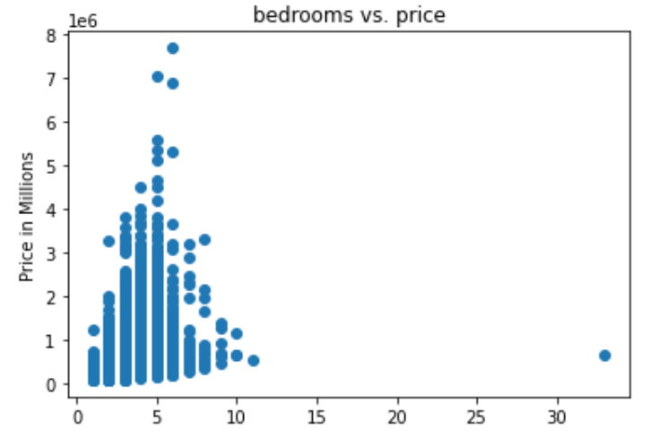
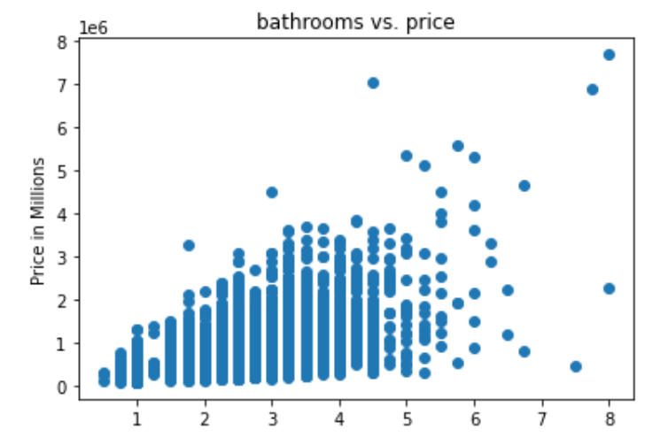
Price vs. Bedrooms | Price vs. Bathrooms
Notes:
Charts

Slide 20
Available Data
King County House Sales dataset
`price` - Sale price (prediction target)
`bedrooms` - # of bedrooms
`bathrooms` - # of bathrooms
`sqft_living` - Square footage of living space in the home
`zipcode` - USPS ZIP Code
`long` - Longitude coordinate
REMOVED: Redundant, Null and Irrelevant data
DERIVED: ‘price per sqft’
Income and Population for Each Zip Code
Notes:
Unused data columns: `id`, `date`, `sqft_lot`, `floors`, `waterfront`, `view`, `condition`, `grade`, `sqft_above`, `sqft_basement`, `yr_built`, `yr_renovated`, `lat`, `sqft_living15`, `sqft_lot15`

